Slide 1
Machine learning

Slide 2
What i machine learning:-
Machine learning (ML) is the study of computer algorithms that can improve automatically through experience and by the use of data. It is seen as a part of artificial intelligence. Machine learning algorithms build a model based on sample data, known as training data, in order to make predictions or decisions without being explicitly programmed to do so. Machine learning algorithms are used in a wide variety of applications, such as in medicine, email filtering, speech recognition, and computer vision, where it is difficult or unfeasible to develop conventional algorithms to perform the needed tasks.

Slide 3
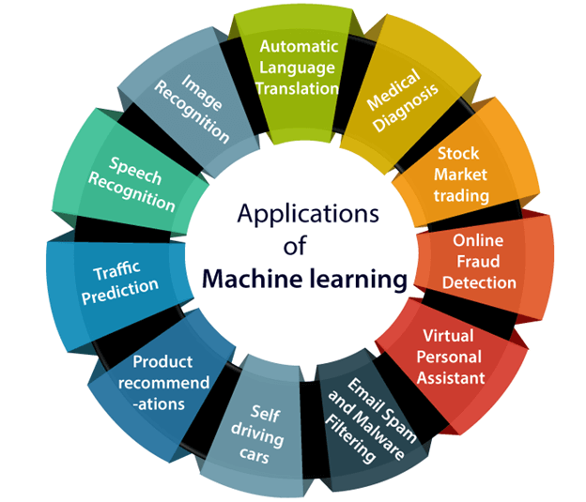
Applications of machine learning :-

Slide 4
Real life scenario :-
Image recognition
Machine learning is also frequently used for facial recognition within an image. Using a database of people, the system can identify commonalities and match them to faces. This is often used in law enforcement.
Speech regcognation:-
Some of the most common uses of speech recognition software are devices like Google Home or Amazon Alexa.
Medical diagnosis:
In the case of rare diseases, the joint use of facial recognition software and machine learning helps scan patient photos and identify phenotypes that correlate with rare genetic diseases.

Slide 5
How python is very useful and supportive languages for machine learning
Python offers concise and readable code. While complex algorithms and versatile workflows stand behind machine learning and AI, Python’s simplicity allows developers to write reliable systems.
Python code is understandable by humans, which makes it easier to build models for machine learning.
To reduce development time, programmers turn to a number of Python frameworks and libraries. A software library is pre-written code that developers use to solve common programming tasks. Python, with its rich technology stack, has an extensive set of libraries
Platform independence

